Slide 1
Optimizing Flights
Jaclyn & Charles - May 9, 2013

Slide 2
Why we Optimize
The goal of optimizing flights is to strategically alter high performing campaigns and to reallocate the majority of budget to maximize performance.
You always want 4-5 high performing campaigns running for each flight
If < 4, create new campaigns

Slide 3
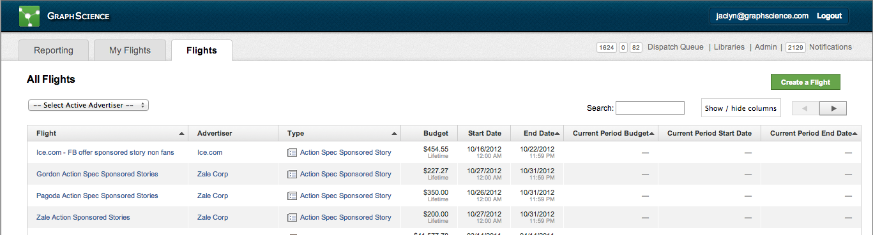
Let's Do An Example!
We will use "Coop BP Prom" as an example.
search flight name

Slide 4
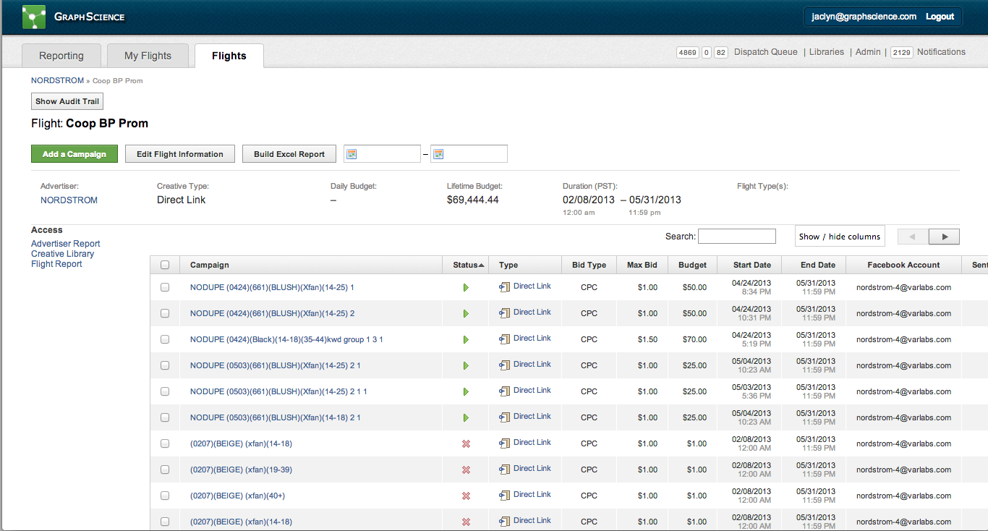
go to Flight Report

Slide 5
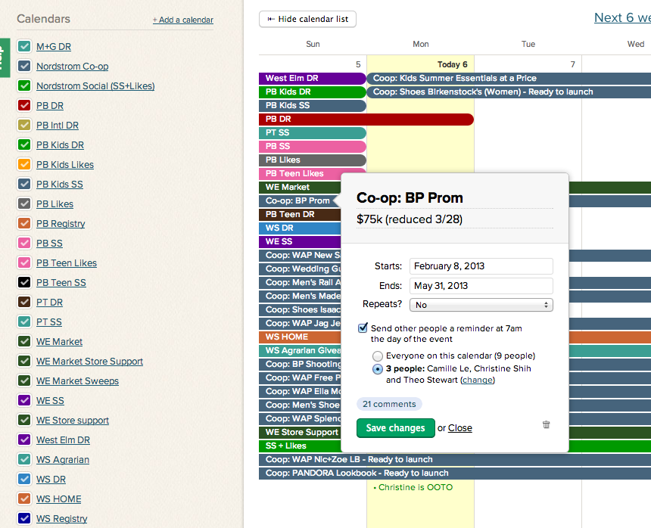
Check Basecamp
Make sure to go to Basecamp calendar and the Flight thread to check for any updates
check for any change in budget, pause dates, or any additional images that Theo/Kateland wants you to use

Slide 6
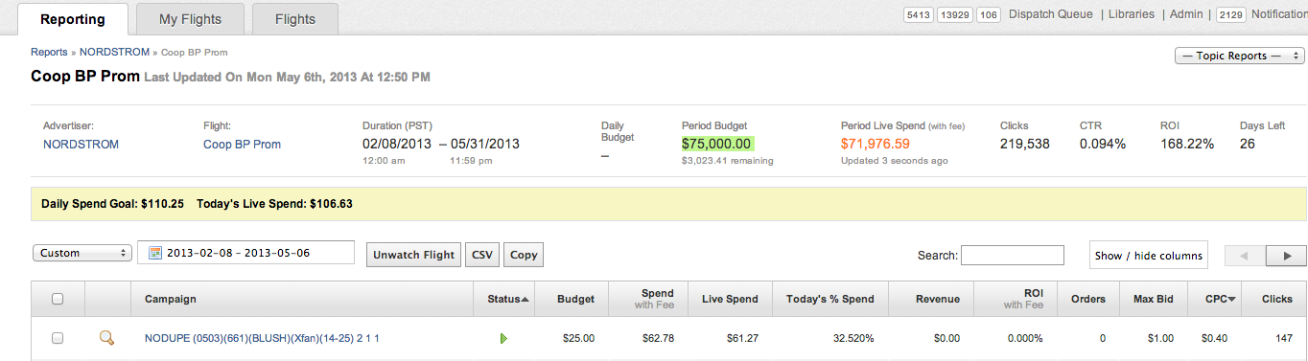
Calculate daily budget!
1. Period Budget - (Larger of Spend with Fee or Live Spend)
The Spend with Fee value should be found for the period flight only.
2. Divide this value by the Days Left to get your own calculated Daily Spend Goal
In this example: $75000 - ($72069.16) = 2930.84
2930.84/26 = $112.73 budget per day

Slide 7
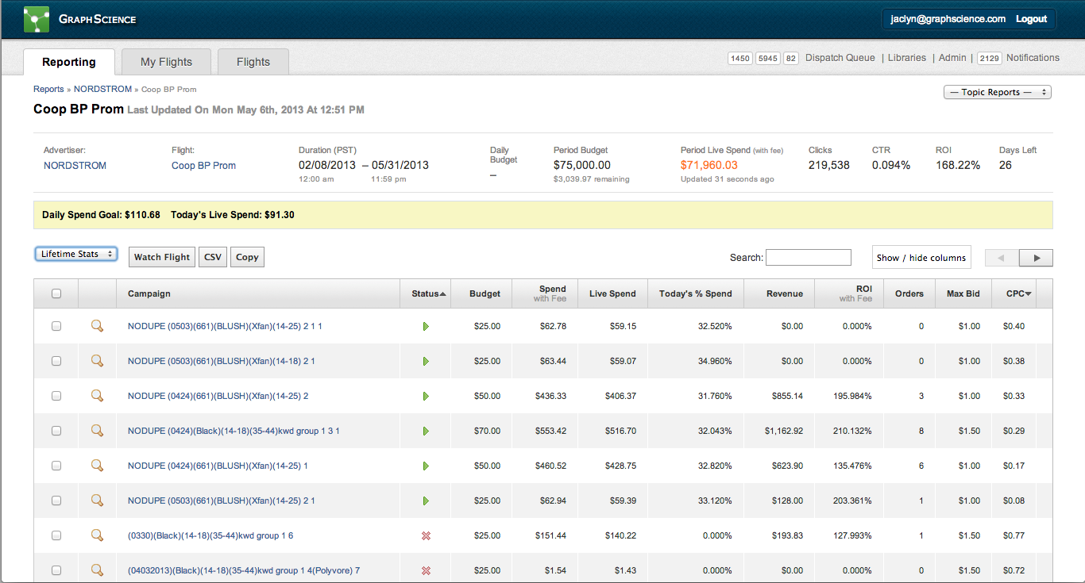
Change to view "Past 7 Days", "Past 3 Days", and "Yesterday"

Slide 8
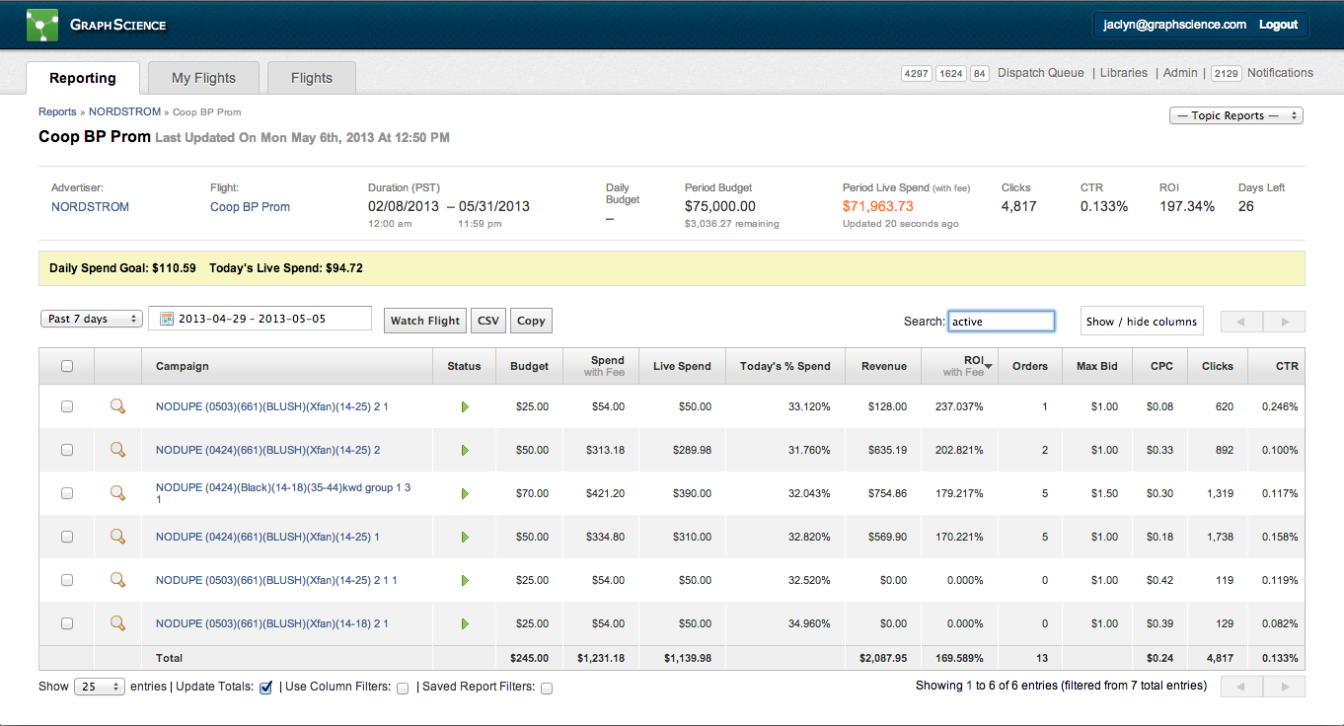
sort by ROI and filter active
Pause campaigns that were running for more than 4 days and not doing well (0 ROI).

Slide 9
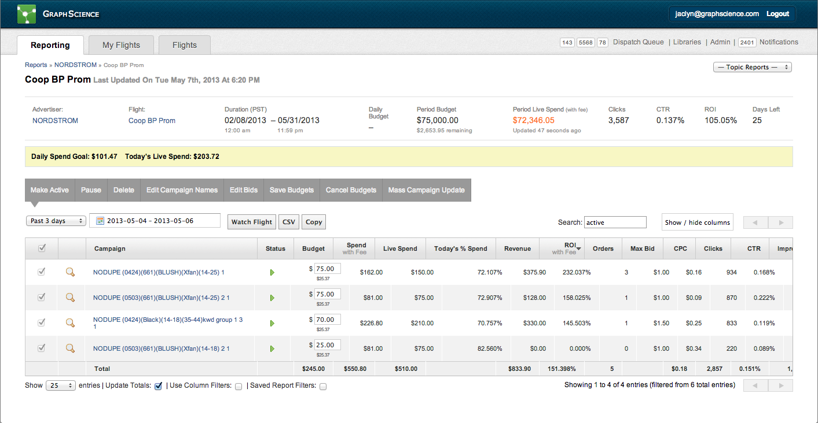
Distribute calculated Daily Spend Goal to campaigns based on its performance (i.e. look at ROI and CTR)

Slide 10
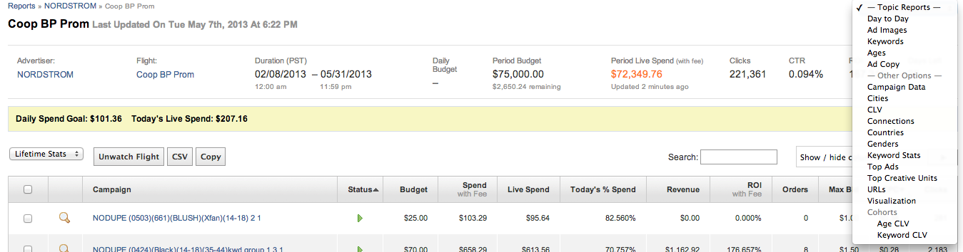
Go to Topic Reports to see the top keywords, images, or age groups
This gives you an idea of the best assets to use in creating new campaigns using top images or keywords
Congratulations! You have optimized a flight!

